Slide 1
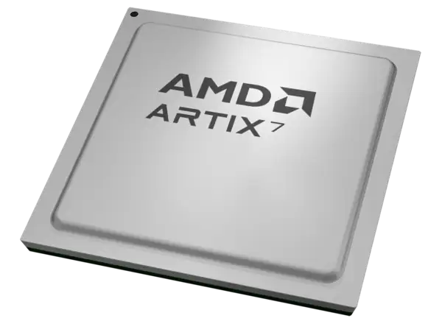
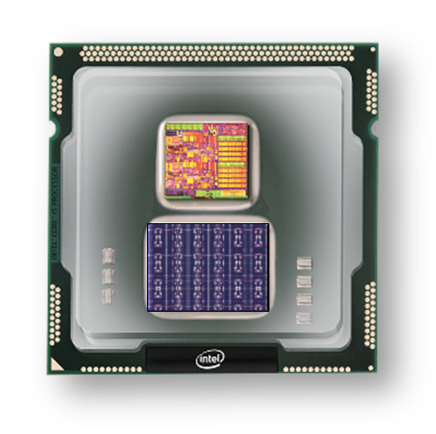

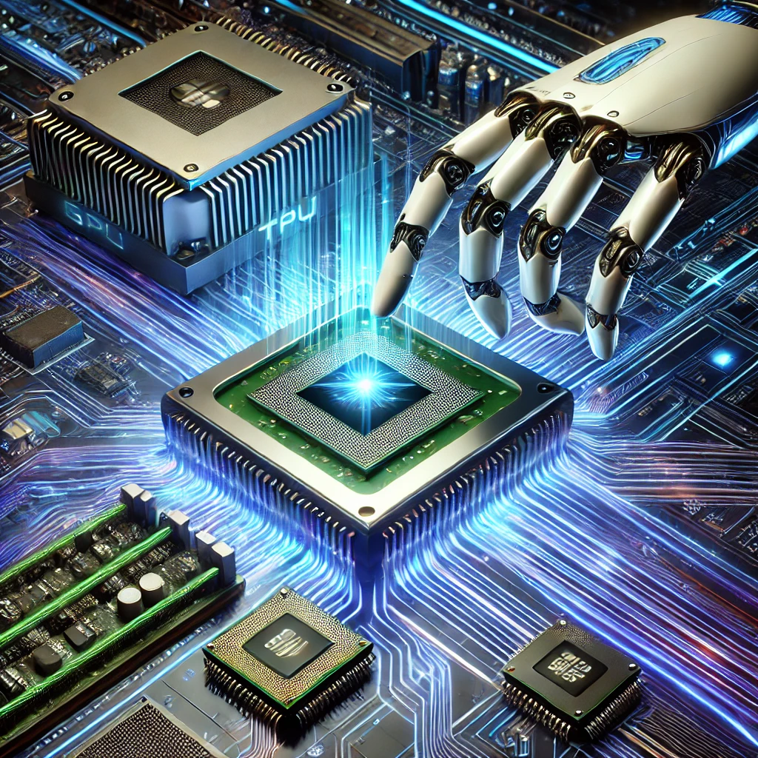
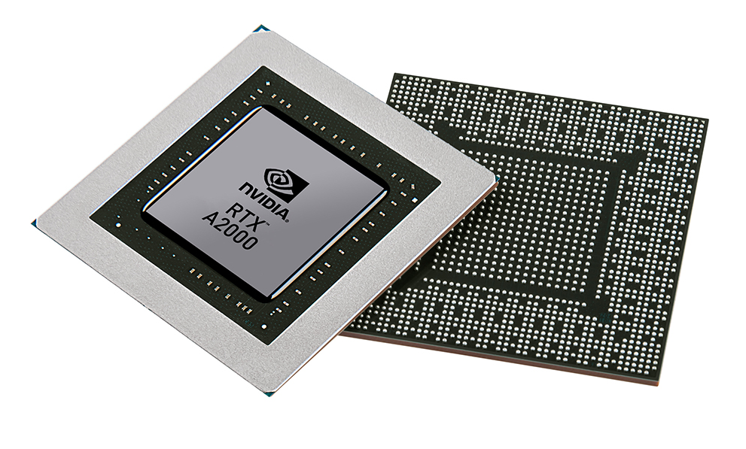


Christof Teuscher
ECE 410/510: Hardware for AI and ML
Week 7: Recap, outlook, and reminders
Portland State University
Department of Electrical and Computer Engineering (ECE)
www.teuscher-lab.com
teuscher@pdx.edu

Slide 2
What did you learn last week?

Slide 3
Recap
How can we accelerate an algorithm?
What are the most promising ways to do so today?
What are the biggest bottlenecks in today’s traditional computing architectures?
What is a non-von Neumann architecture?
What is in-memory computation.
What is one way to realize in-memory computation?

Slide 4
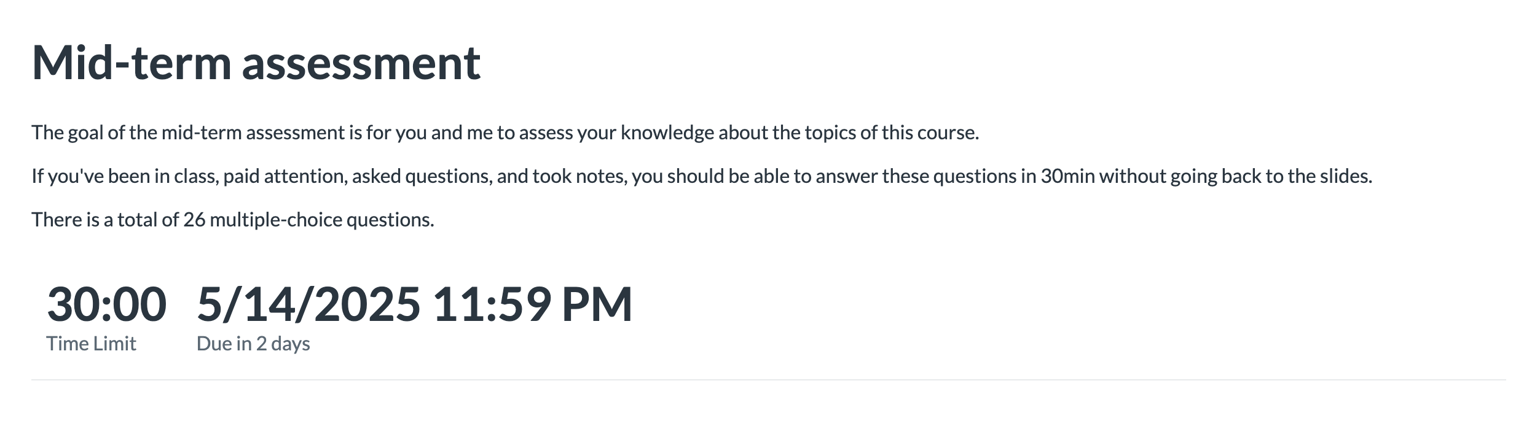
Reminder

Slide 5
Week | Monday | Wednesday (Codefest)
2 | HW/AI/ML overview + codesign overview | Start main project: pick workload, start analysis, benchmark, …
3 | GPU architecture and programming for AI | Drafting a HW architecture, creating a model
4 | Deep neural networks on GPUs | Coding HW description
5 | Transformers on GPUs | First simulation + refinement
6 | In-memory computation | Improving initial design
7 | Neuromorphic chips: TrueNorth, Loihi, Akida | Simulation + refinement
8 | Neuromorphic computing with mem-devices | Synthesizing design + benchmarking
9 | Hardware accelerators for embedded systems | Final improvements
10 | Emerging technologies and future directions | Final tests, validation, verification, benchmarking
Memorial Day

Slide 6
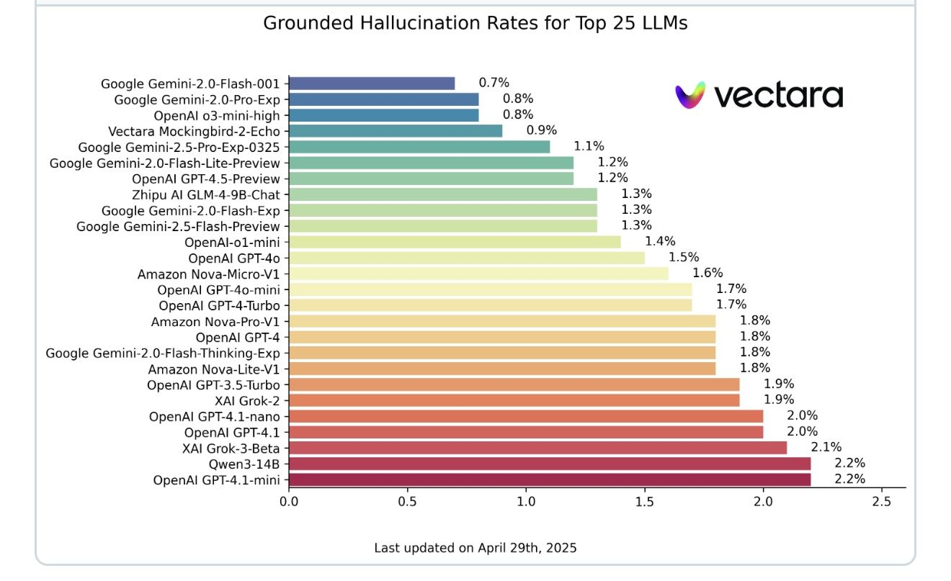
Hallucination leaderboard: https://github.com/vectara/hallucination-leaderboard

Slide 7


Slide 8
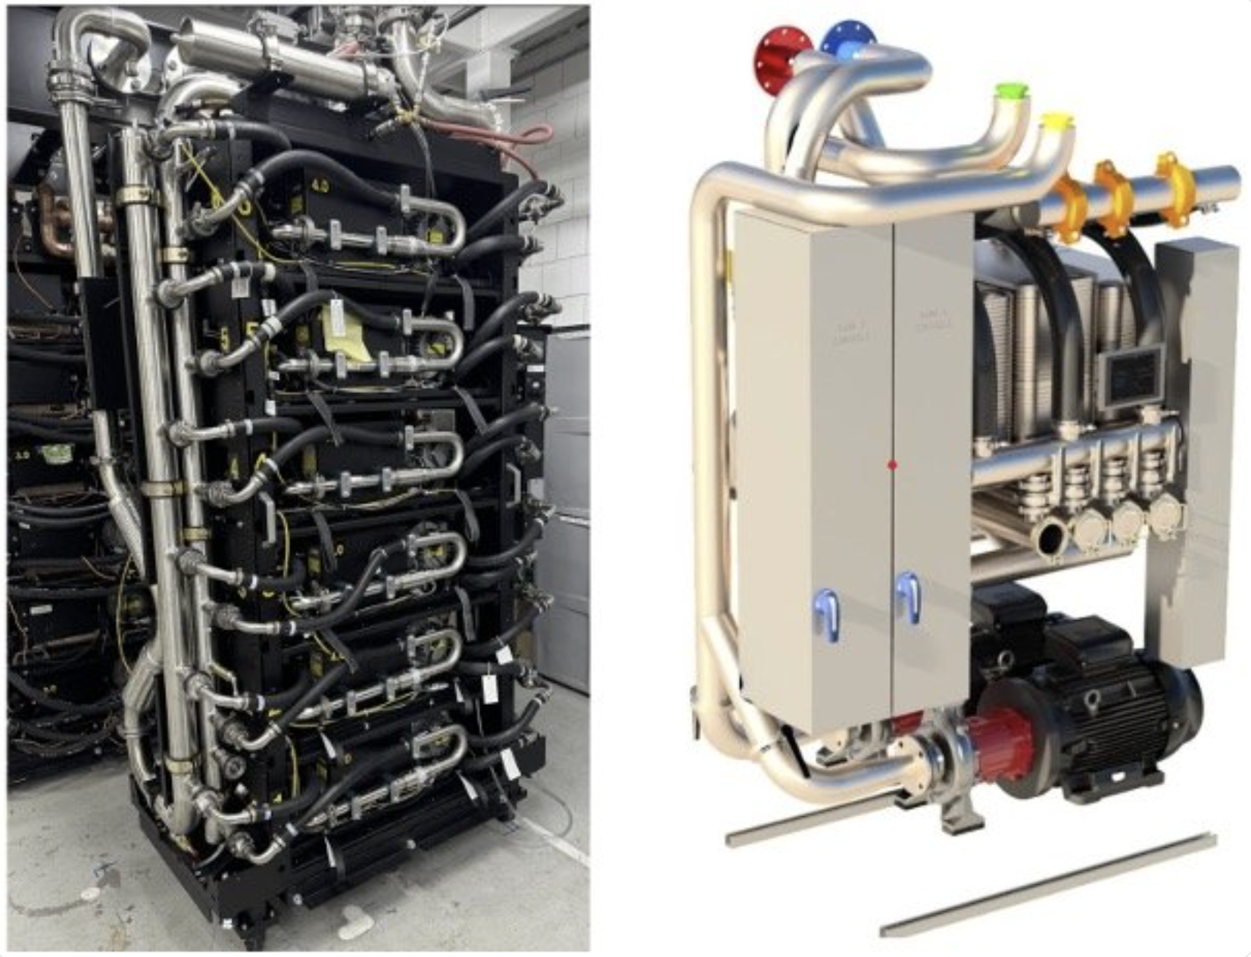
“The dramatic increase in chip power consumption — from 100W chips to accelerators exceeding 1000W — has made advanced thermal management essential.”
“We are excited to introduce +/-400 VDC power delivery that can support up to 1 MW per rack.”
~1,200 homes!
https://cloud.google.com/blog/topics/systems/enabling-1-mw-it-racks-and-liquid-cooling-at-ocp-emea-summit

Slide 9
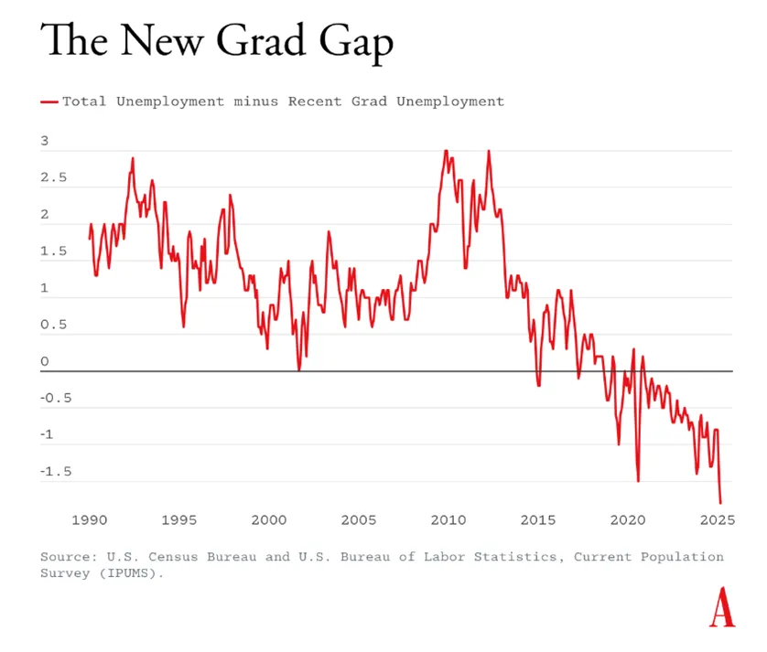
AI can do low-level work that you as an entry level grad without job experience would do.
Leaving gaps in your basic knowledge is a key ingredient in the recipe for professional failure.
https://www.theatlantic.com/economy/archive/2025/04/job-market-youth/682641/

Slide 10
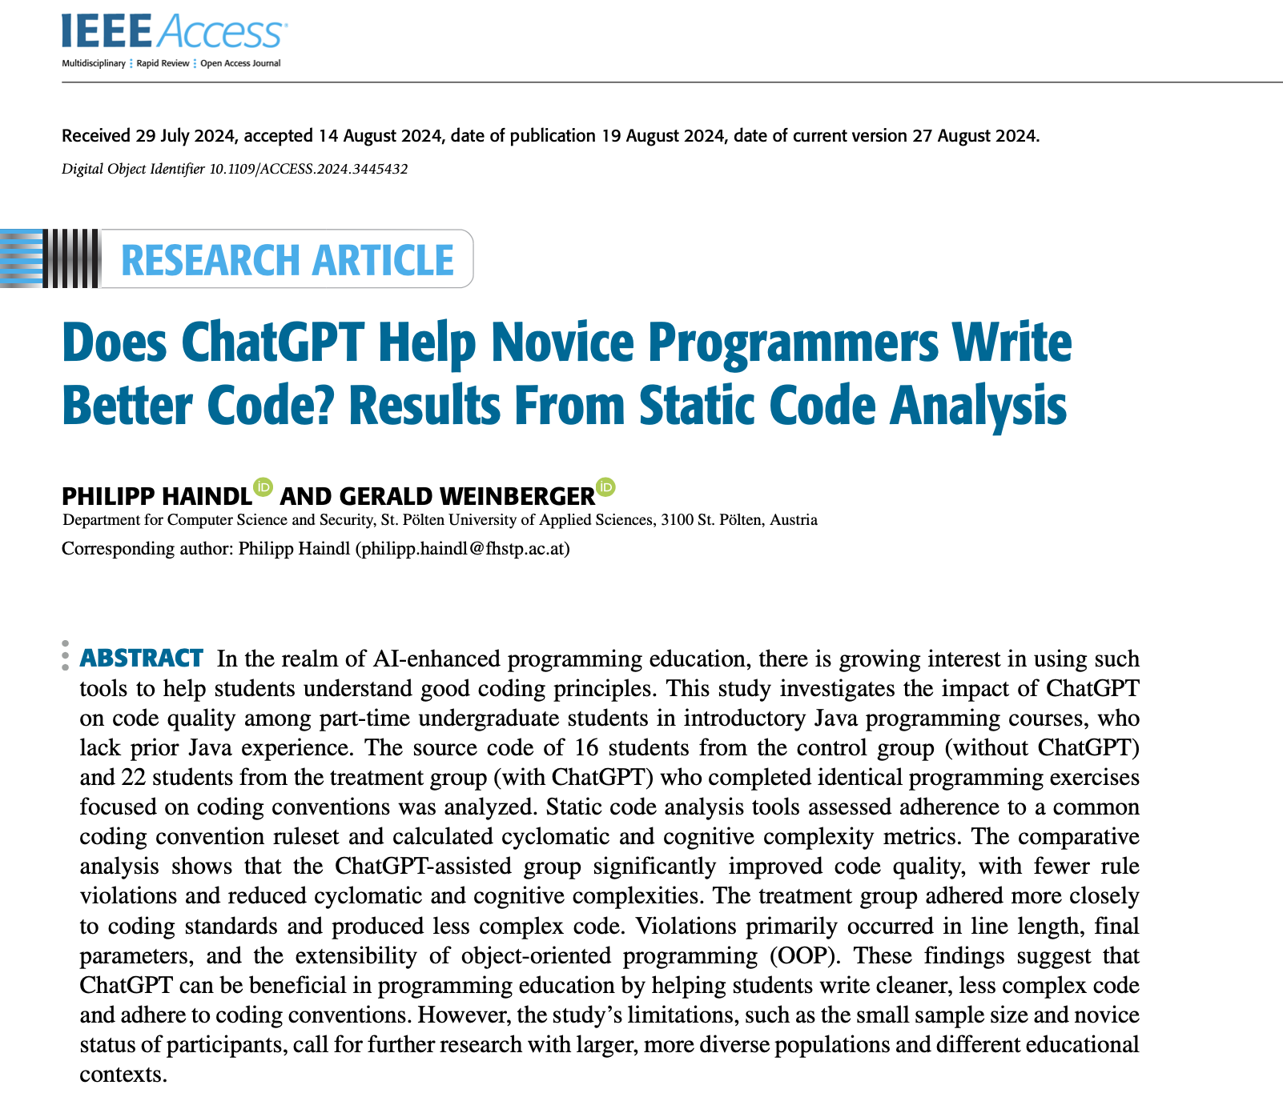
“The comparative analysis shows that the ChatGPT-assisted group significantly improved code quality, with fewer rule violations and reduced cyclomatic and cognitive complexities.”
“These findings suggest that ChatGPT can be beneficial in programming education by helping students write cleaner, less complex code and adhere to coding conventions.”
https://ieeexplore.ieee.org/abstract/document/10638538

Slide 11
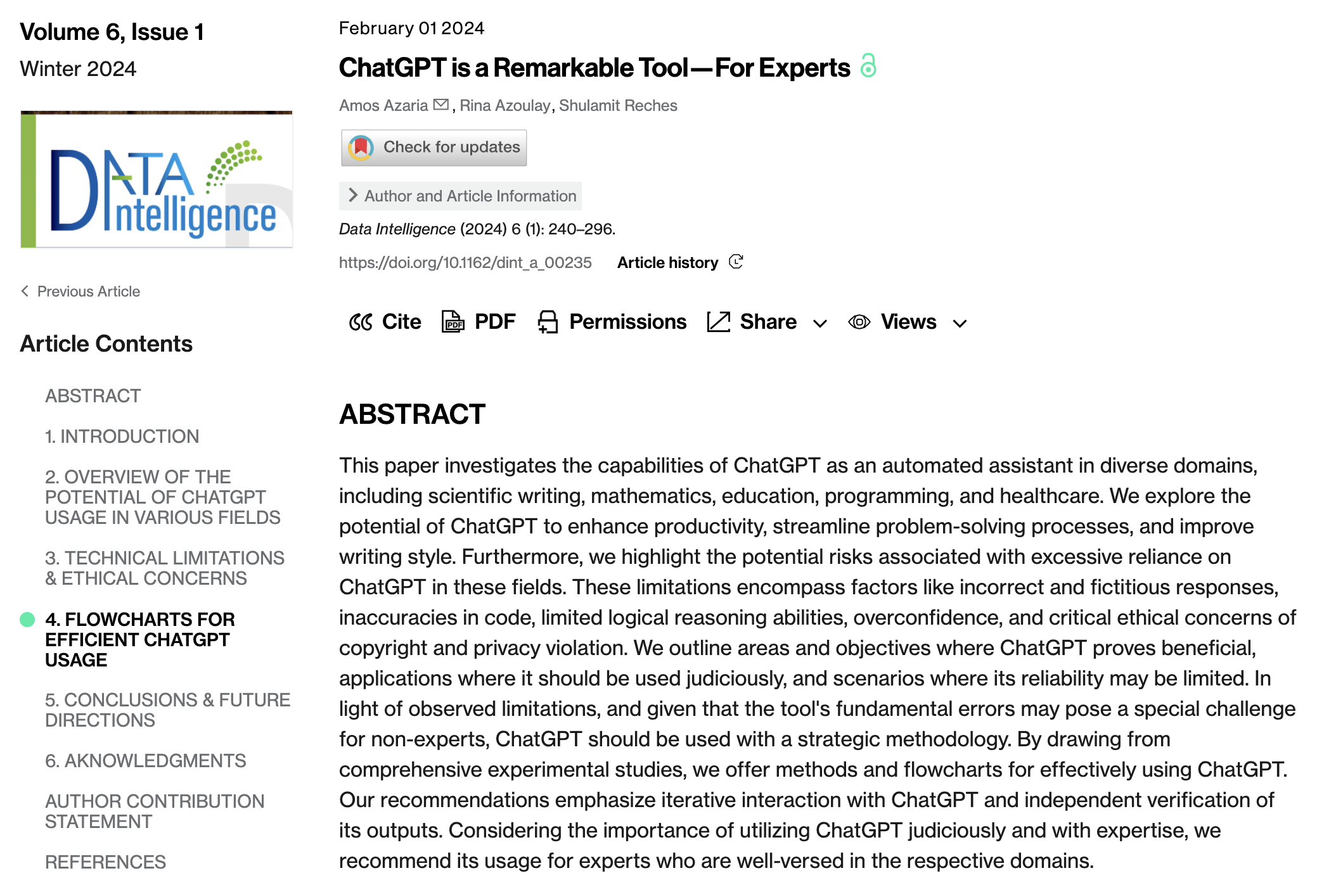
“Our recommendations emphasize iterative interaction with ChatGPT and independent verification of its outputs. Considering the importance of utilizing ChatGPT judiciously and with expertise, we recommend its usage for experts who are well-versed in the respective domains.”
https://direct.mit.edu/dint/article/6/1/240/118046

